Slide 1

School Recycling Program

Slide 2

Introductions

Slide 3

What is Recycling?
Why is recycling important?
What happens to our stuff when we throw it away?
What is a landfill?
What can be recycled?
What is organic waste?

Slide 4
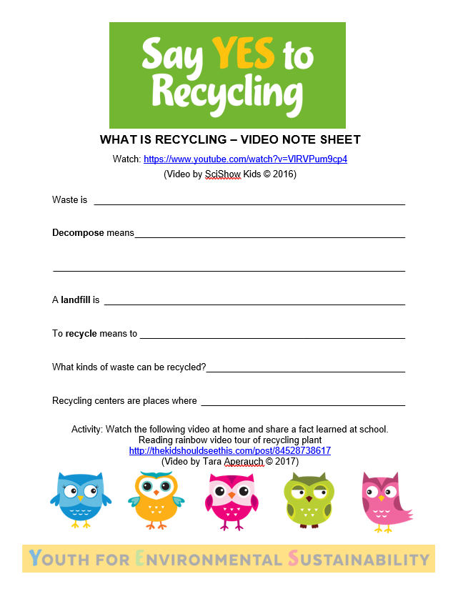
Let’s Watch a Video
https://www.youtube.com/watch?v=VlRVPum9cp4

Slide 5
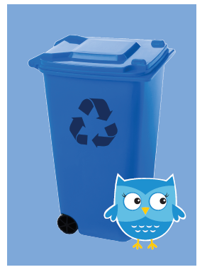
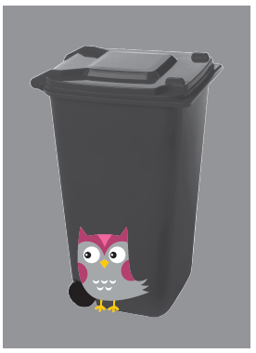
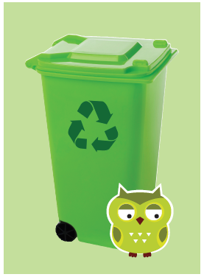
Game Time

Slide 6
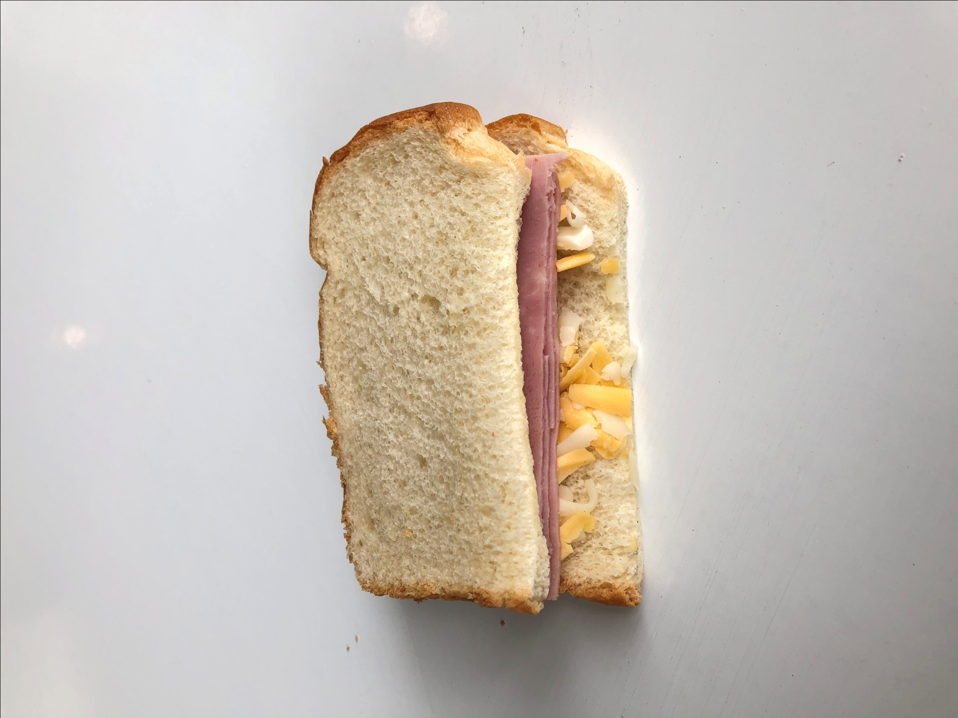

Slide 7
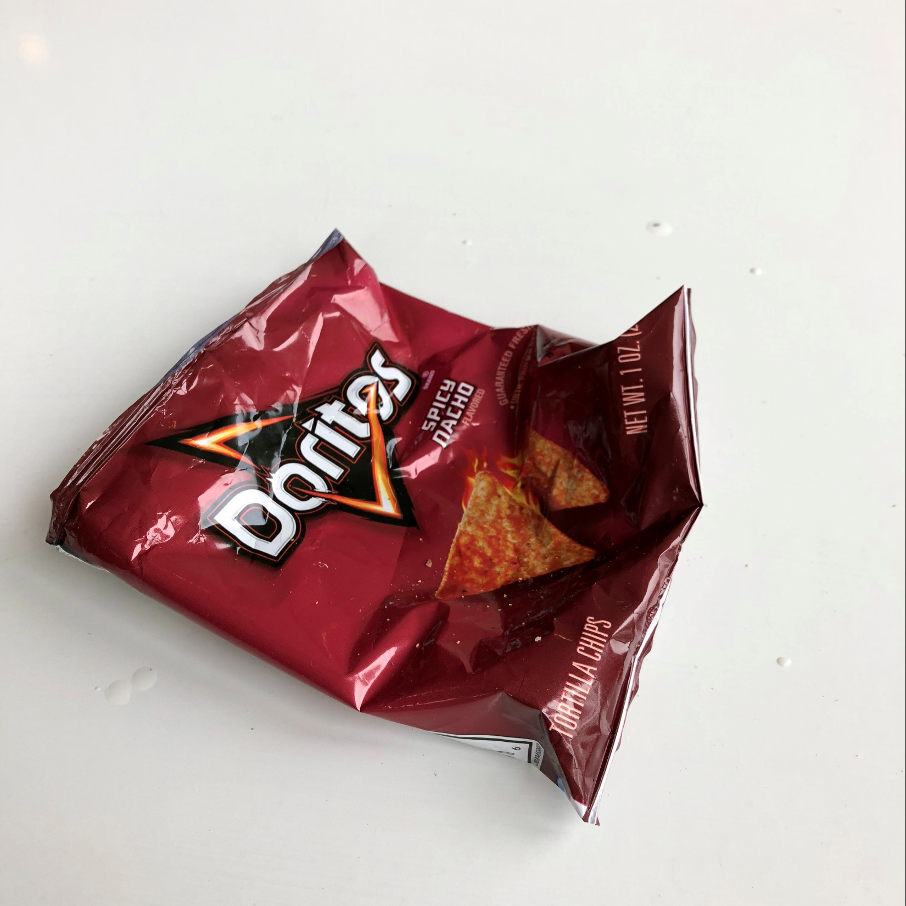

Slide 8
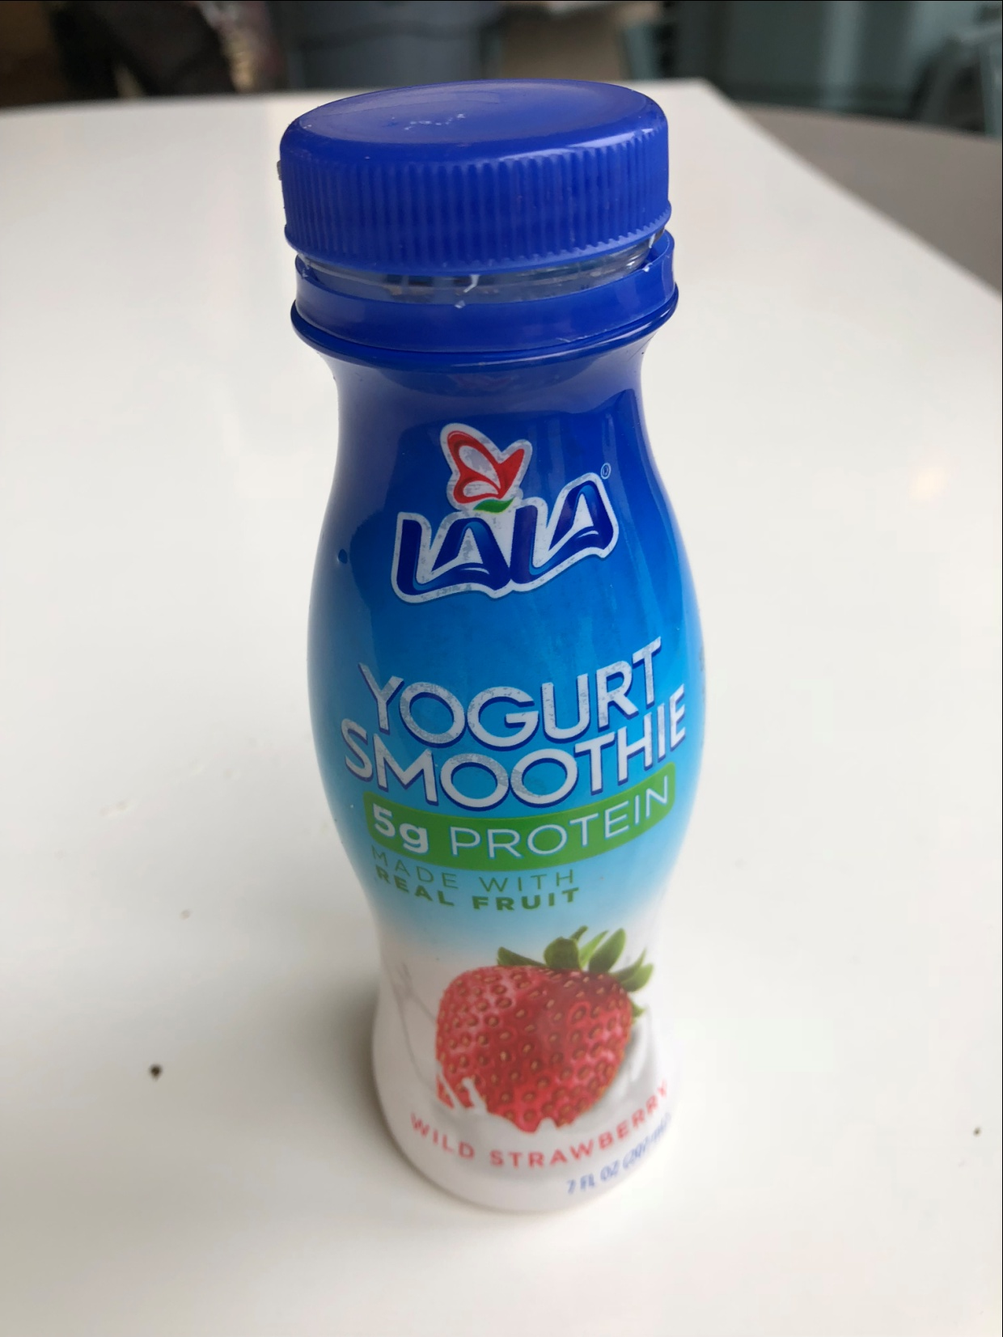

Slide 9
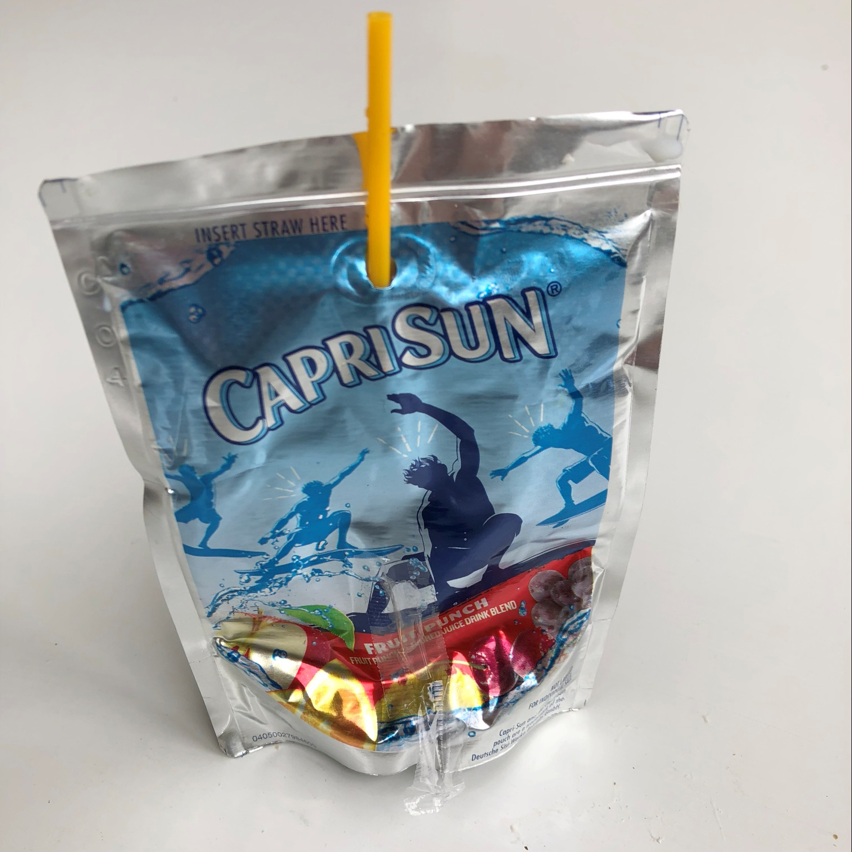

Slide 10
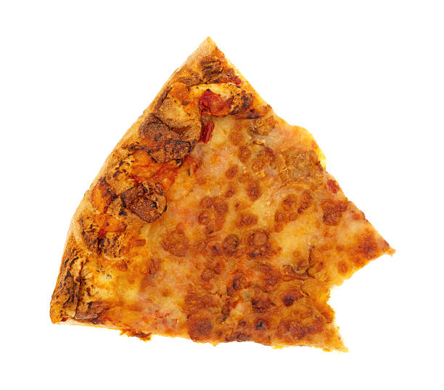

Slide 11
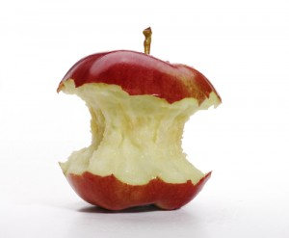

Slide 12


Slide 13


Slide 14


Slide 15
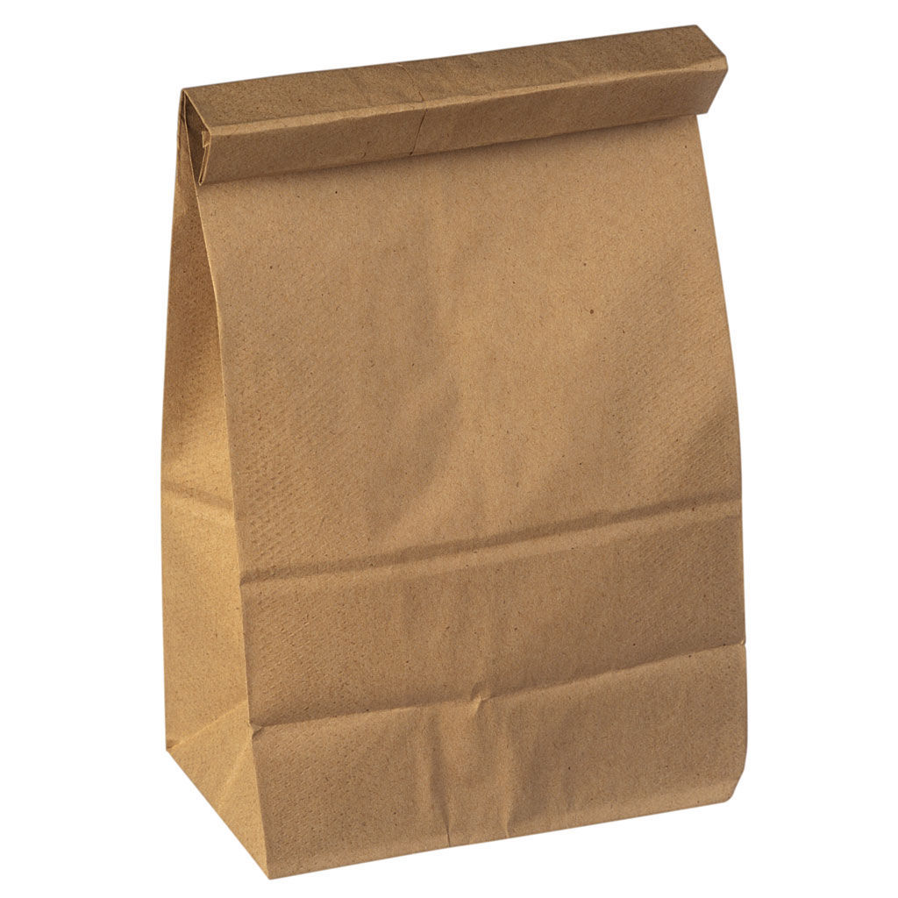

Slide 16


Slide 17


Slide 18
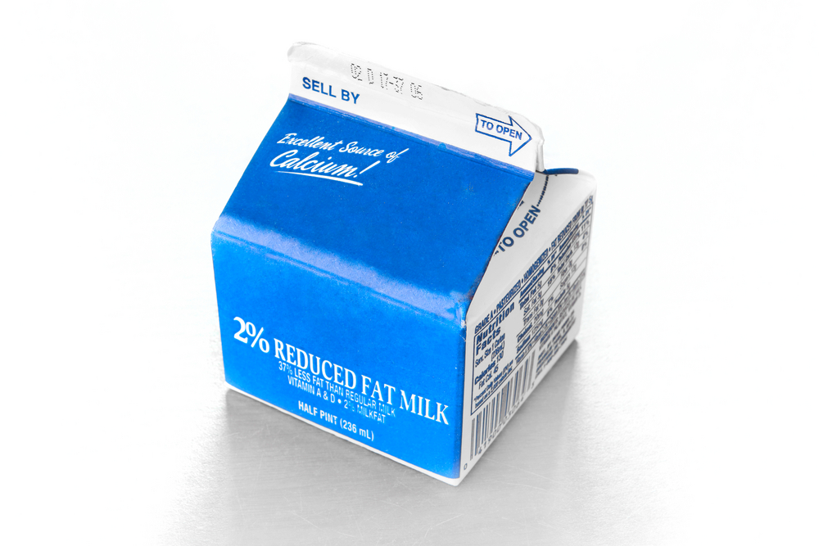

Slide 19
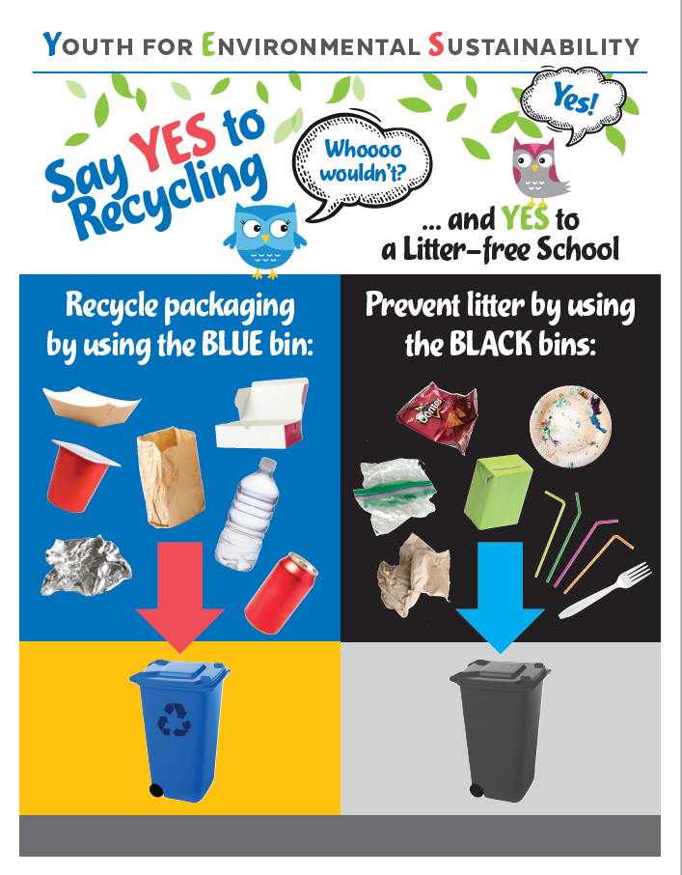
Program Overview
New blue recycling bins placed in classrooms and school common areas
New green organics bins for kitchen
Student pledge to participate
Interdisciplinary lesson plans

Slide 20
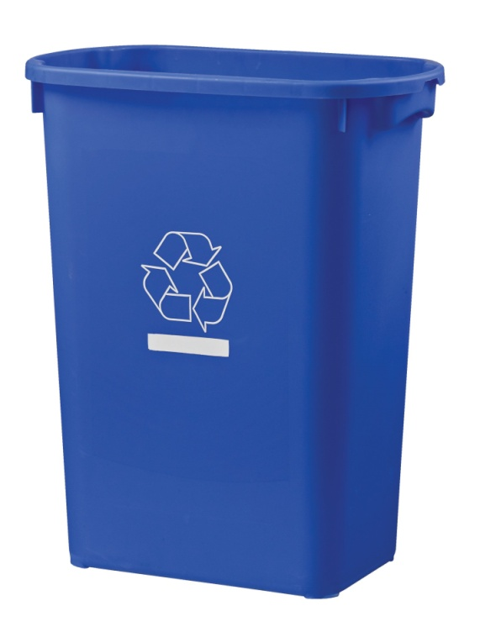
Blue bin recycling
Notes:
To discuss where bins are placed (classroom, cafeteria, admin offices, public space, library), what goes in them

Slide 22
Let’s Watch a Video
https://youtu.be/WJvr5gnrqP4

Slide 23
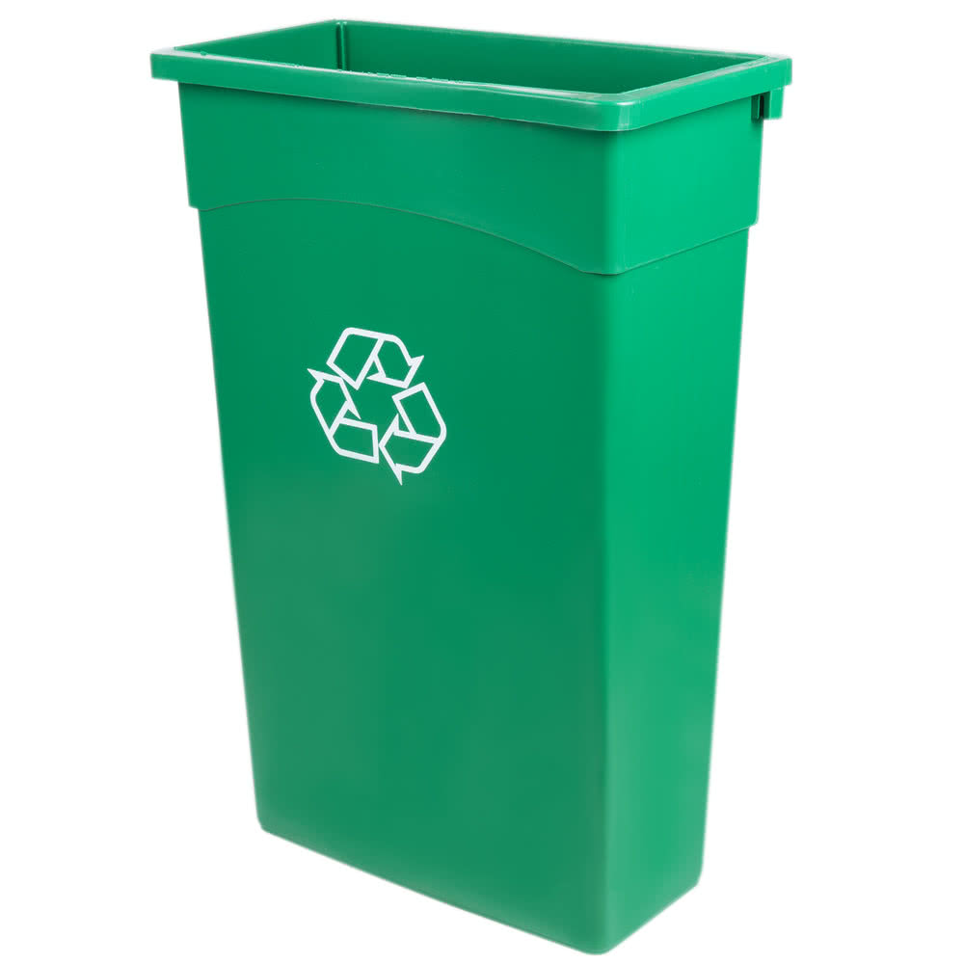
Green bin organics recycling
Notes:
To discuss the bin placement (cafeteria and kitchen) and what goes in the bin

Slide 24
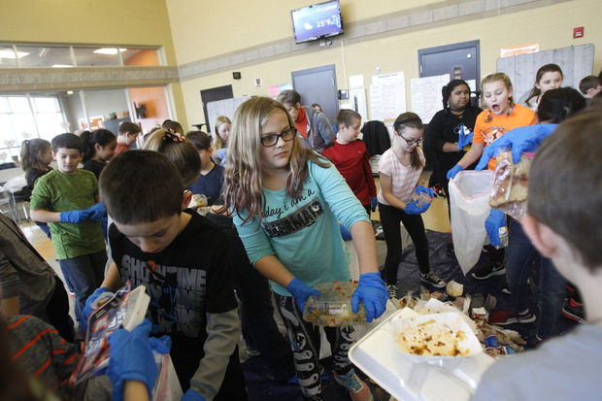
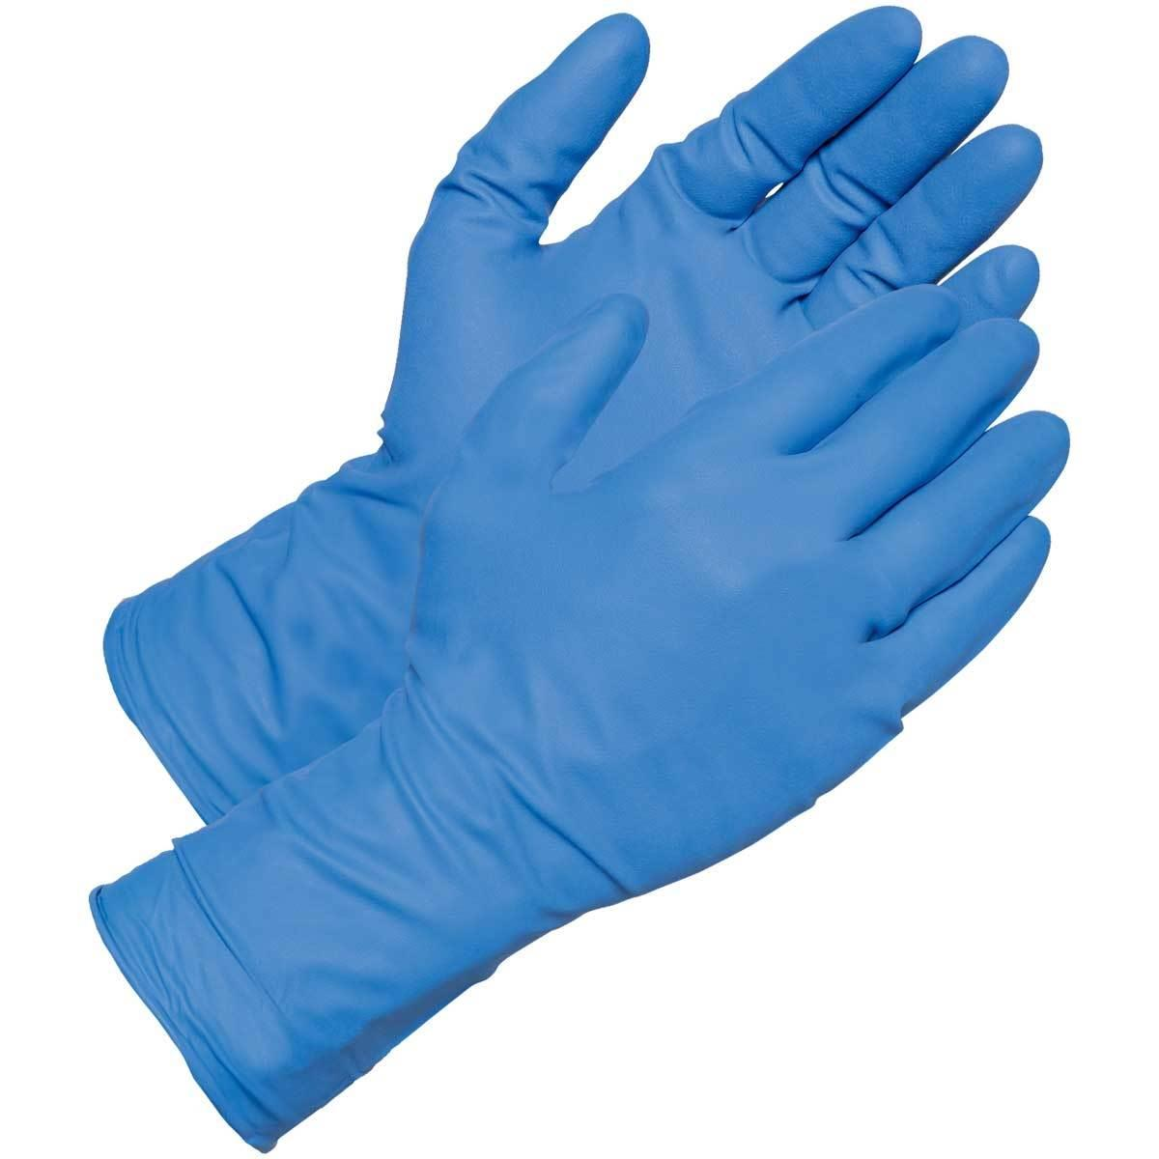
Let’s Sort

Slide 25

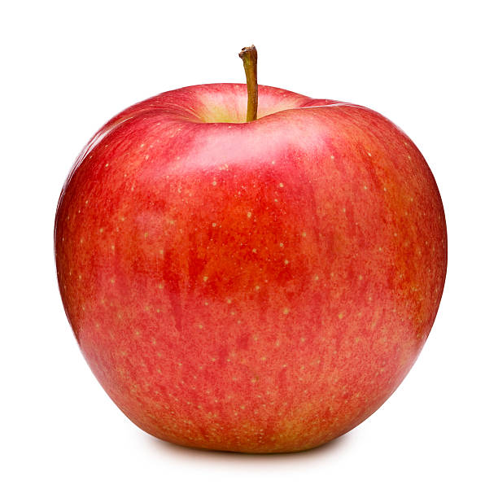
Don’t Toss…Share

Slide 26
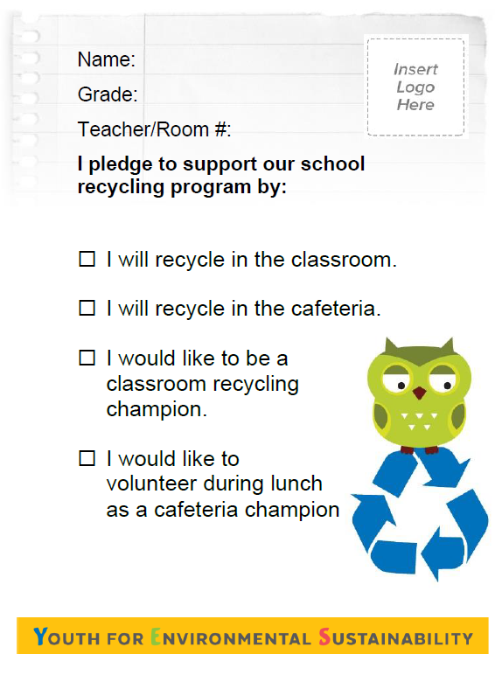
Student pledge
I will recycle in the classroom
I will recycle in the cafeteria
I would like to be a classroom recycling champion
I would like to volunteer during lunch as a Cafeteria Champion
Notes:
To share pledge card, champion signup forms for cafeteria and classroom

