Slide 2
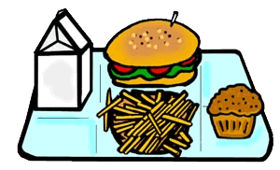
INTRODUCTION - Engage
S2
What did you have for snack or lunch today?
Did you have any leftovers?
What did you do with them?

Slide 3
INTRODUCTION - Engage
S3
What happens to the leftovers after?
Where do they go?

Slide 4
INTRODUCTION - Engage
S4
Make observations
What kind of trash or waste do you see?
Notes:
Photo Source: https://calrecycle.ca.gov/organics/slcp/

Slide 5
INTRODUCTION - Engage
S5
What can we do so we don’t throw away so much food?

Slide 6
INTRODUCTION- Explore
S6
CARD SORT - Activity
Cut and sort the cards.
Sort them into what you think is Organic Waste and Non-organic Waste.

Slide 7
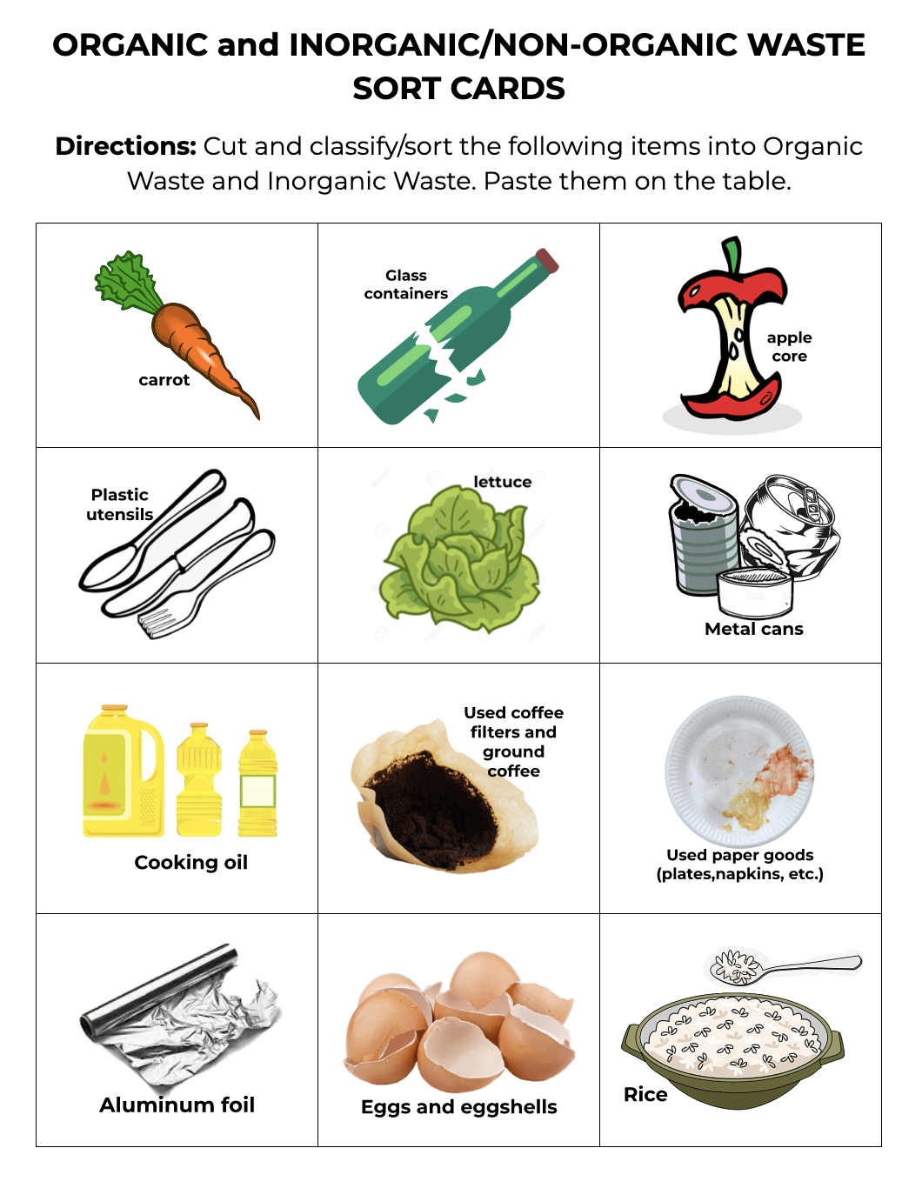
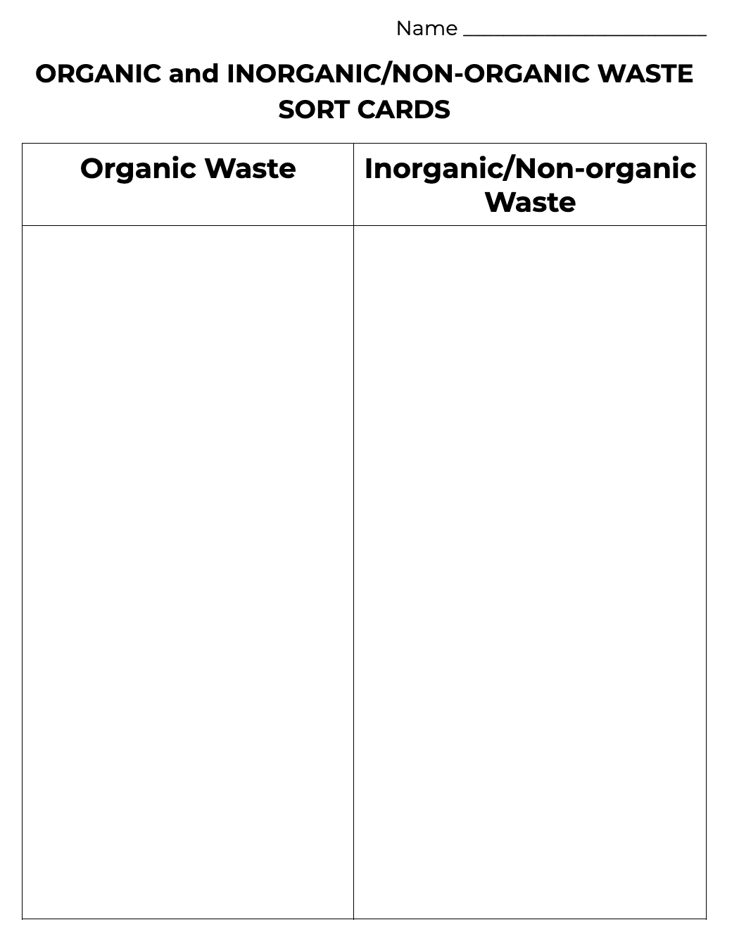
Cut
Sort
S7

Slide 8
INTRODUCTION- Explore
S8
What rule are you using or following?
How are you sorting them?

Slide 9
INTRODUCTION - Student Explain
S9
WRITING PROMPT
Write on your lab book the answers to these questions.
What is organic waste?
What did you use to sort the cards?

Slide 10
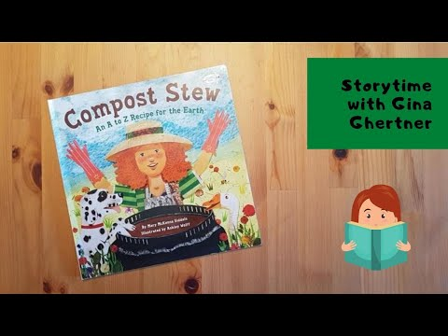
PROCEDURE - Teacher Explain
S10
Kindergarten

Slide 11
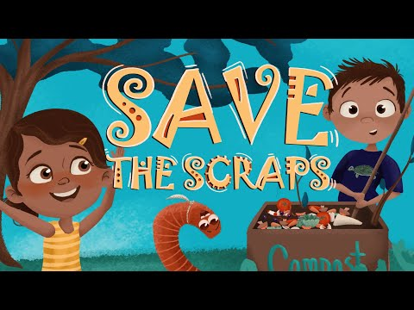
PROCEDURE - Teacher Explain
S11
Grades 1 - 2

Slide 12
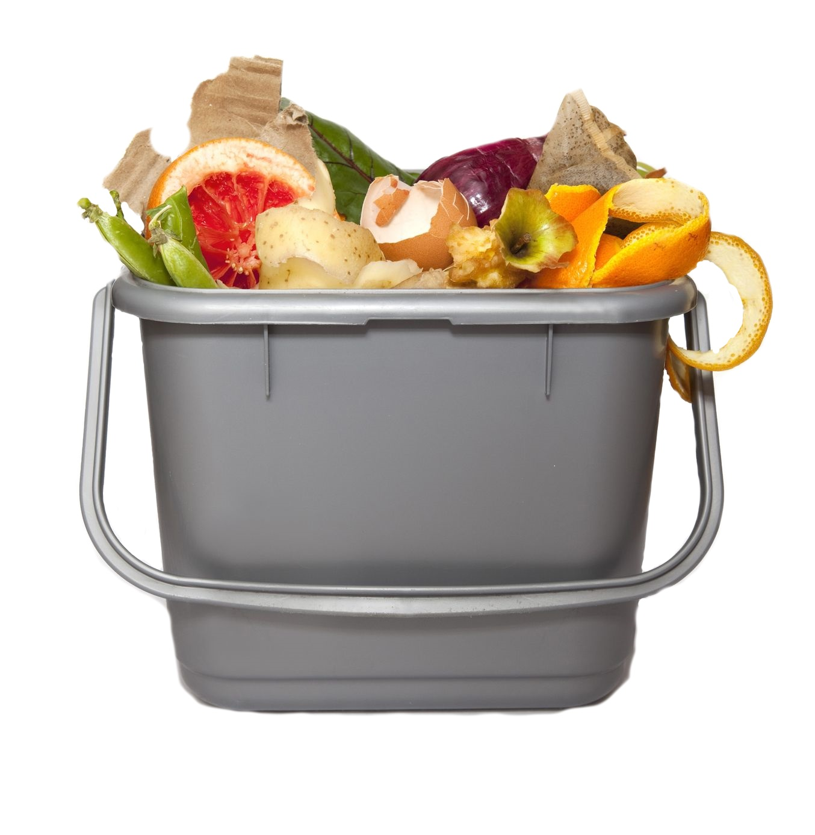
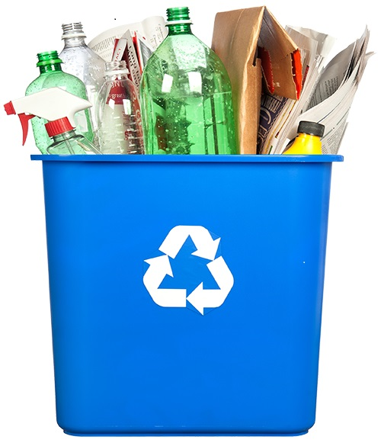
PROCEDURE - Teacher Explain
S12
Separating Food Waste And Recycling

Slide 13
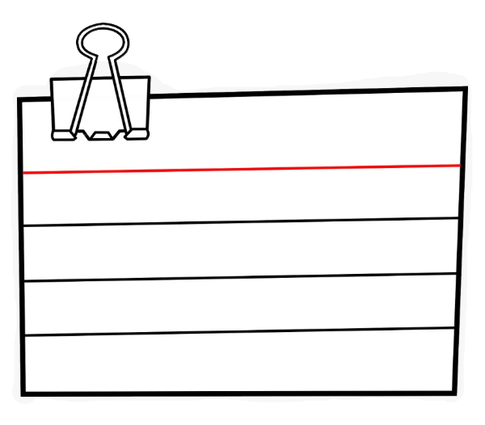
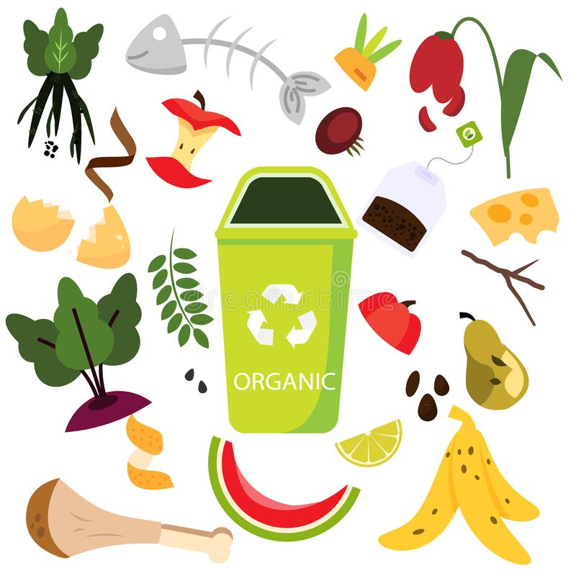
ACADEMIC/SCIENTIFIC VOCABULARY
S12a
ORGANIC WASTE
Any material that derives from either a plant or animal and is biodegradable.

Slide 14
ACADEMIC/SCIENTIFIC VOCABULARY
S12b
BIODEGRADABLE
Organic materials that can break down or decompose.

Slide 15
ACADEMIC/SCIENTIFIC VOCABULARY
S12c
RECYCLING
To process something
in order to regain
material for human use.

Slide 16
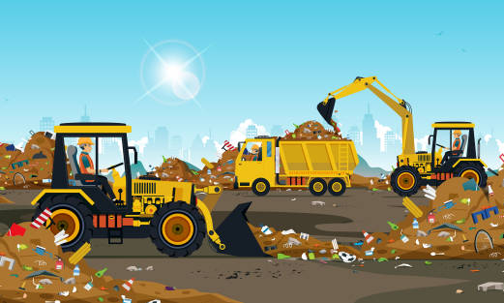
ACADEMIC/SCIENTIFIC VOCABULARY
S12d
LANDFILL
A system of trash disposal
where it is buried between
layers of earth.

Slide 17
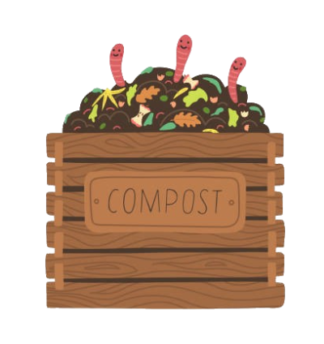
ACADEMIC/SCIENTIFIC VOCABULARY
S12e
COMPOST
A mixture made up of decomposed organic waste that can be used for fertilizer.

Slide 18
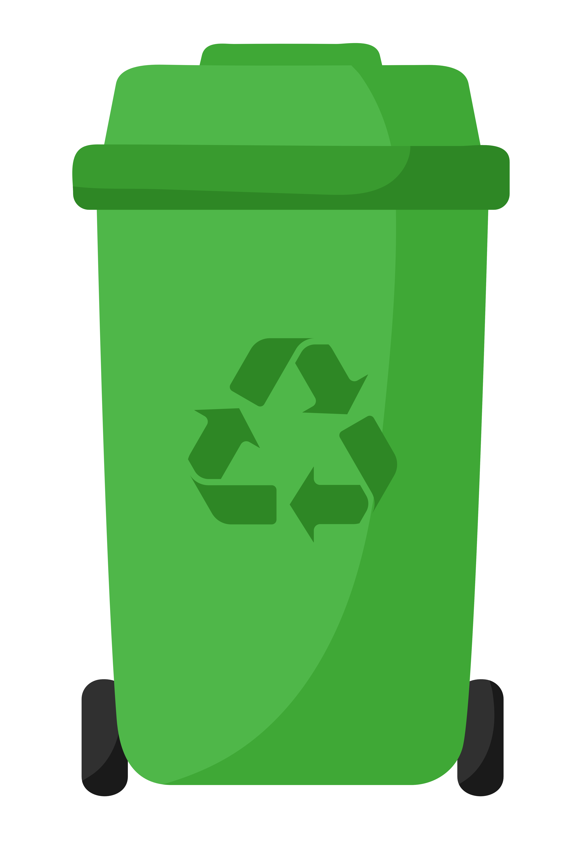
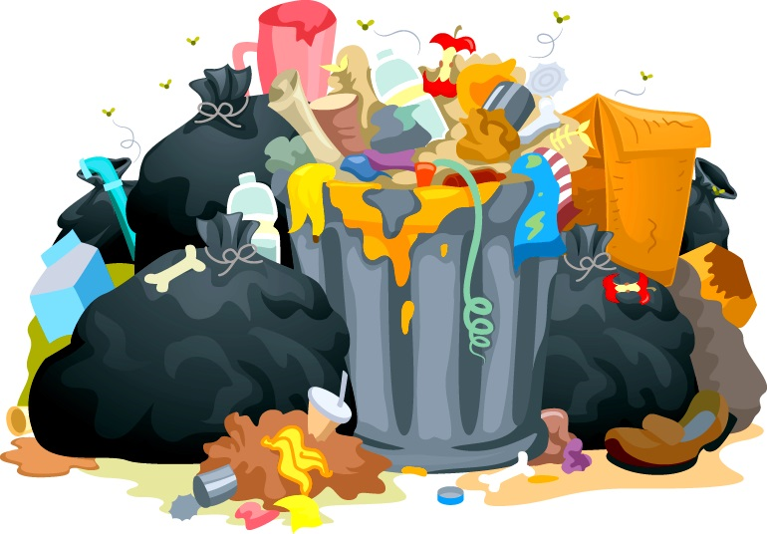
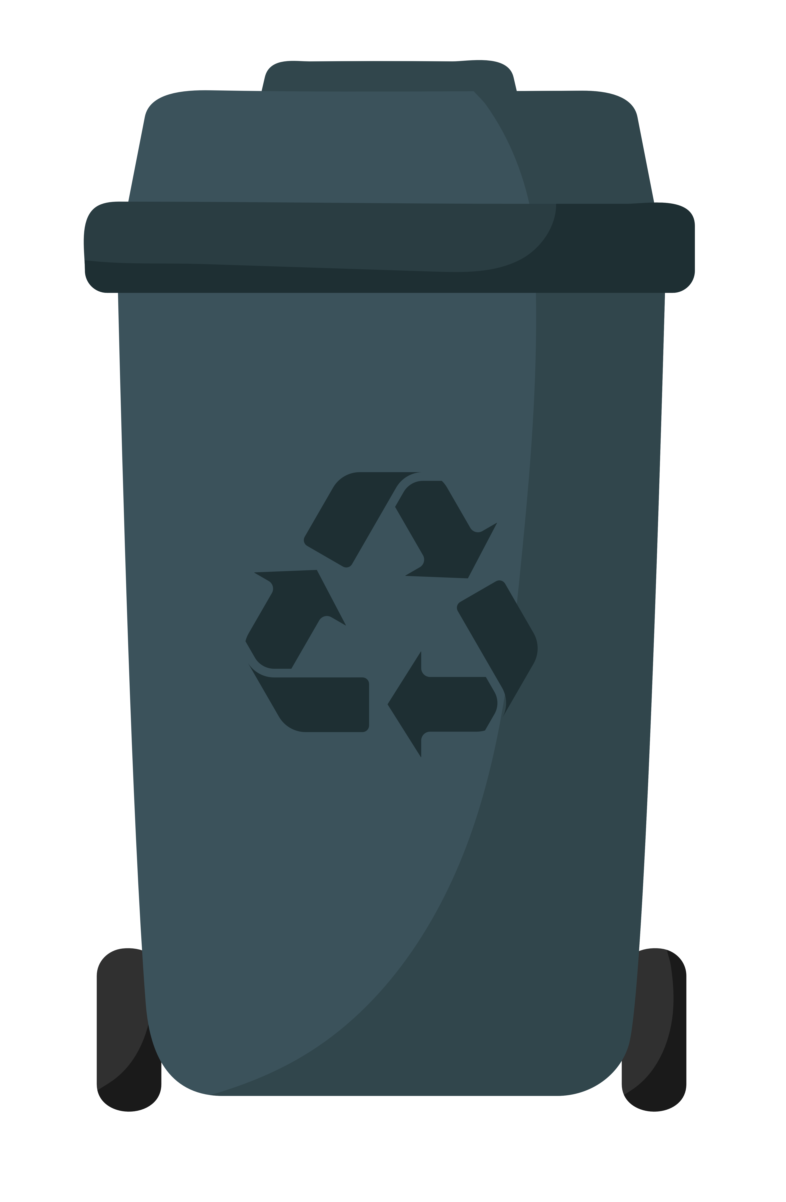
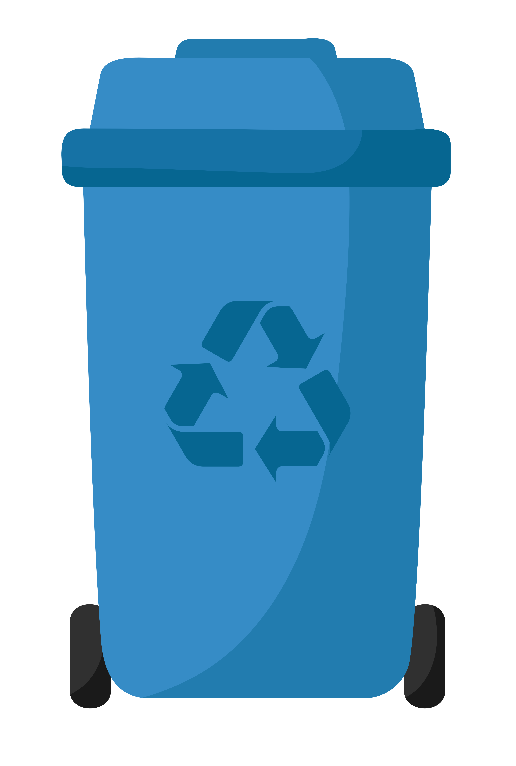
CONCLUSION - Elaborate
S13
Organic
Waste
Inorganic
Waste

Slide 19
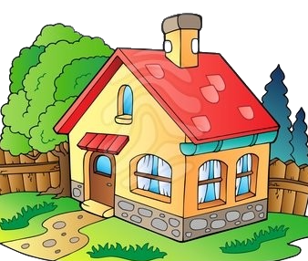
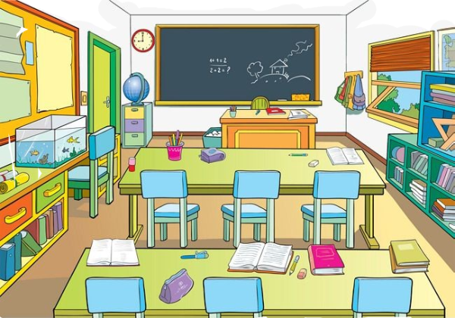
CONCLUSION - Extend
S14
How can we reduce organic waste…
…at home?
…at school?
…in the classroom?

